Slide 1
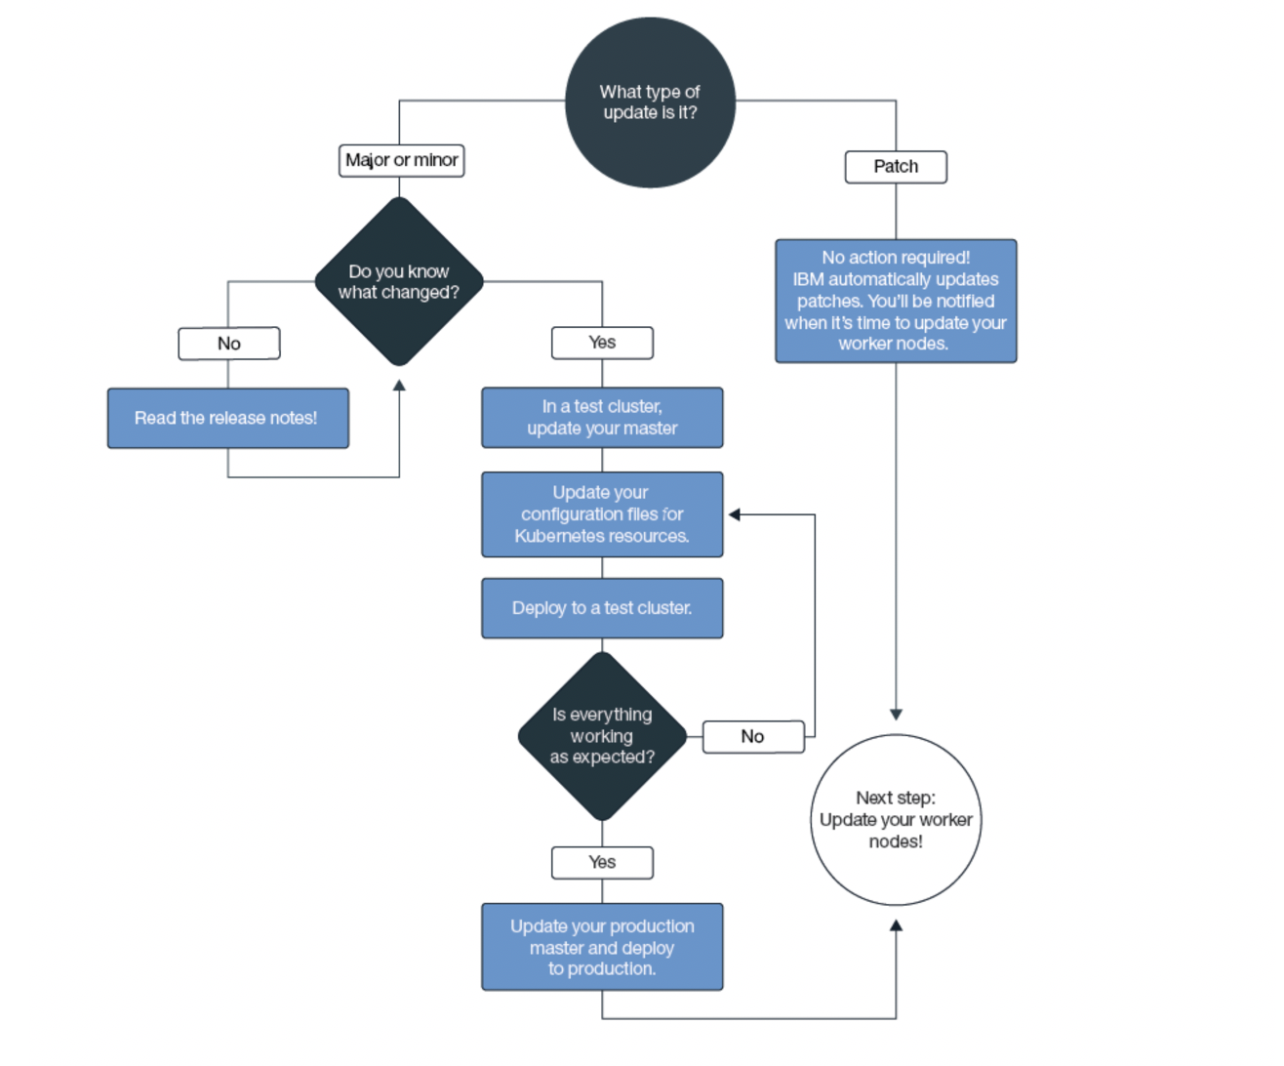
Updates to the OpenShift platform (masters, workers)
Platform updates happen!
Security fixes (typically patches)
New features
API (e.g. Kubernetes) updates
Patch updates are automatically rolled out by IBM to master nodes
Cluster admins choose when to implement master updates for major/minor updates
Flow diagram for handling major, minor and patch updates
Source: https://cloud.ibm.com/docs/openshift?topic=openshift-update#master

Slide 2
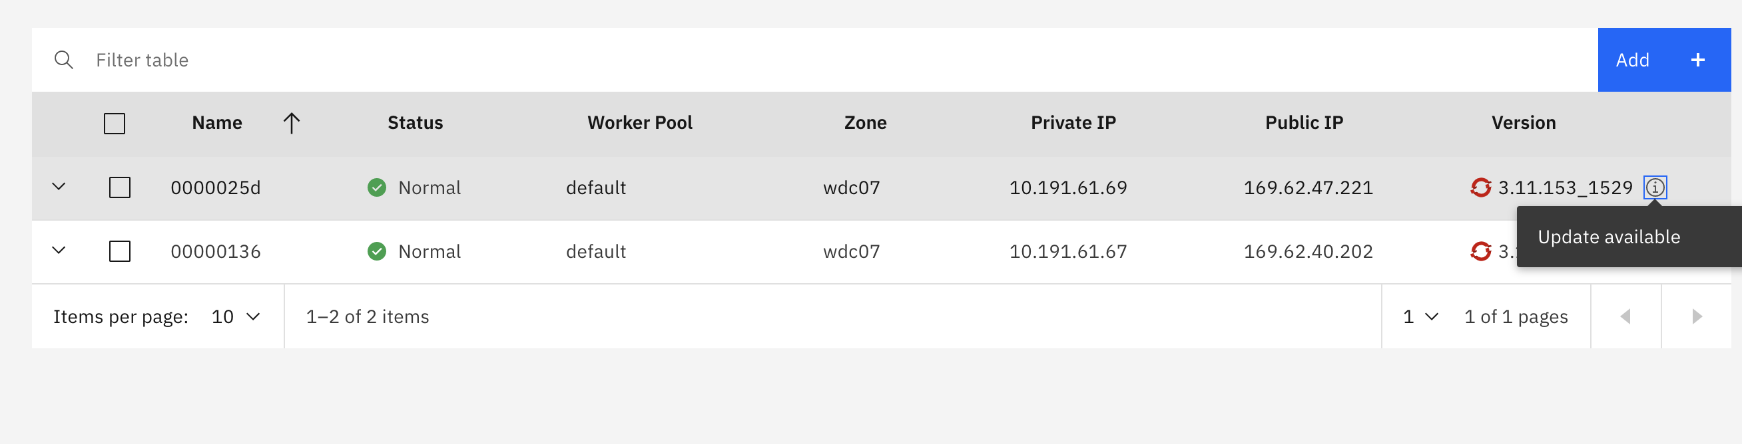
Updating clusters, worker nodes, and cluster components

Slide 3
Updating clusters, worker nodes, and cluster components
Updating worker nodes (masters already updated)
You received a notification to update your worker nodes. What does that mean? As security updates and patches are put in place for the API server and other master components, you must be sure that the worker nodes remain in sync.
What happens to my apps during an update? If you run apps as part of a deployment on worker nodes that you update, the apps are rescheduled onto other worker nodes in the cluster. These worker nodes might be in a different worker pool, or if you have stand-alone worker nodes, apps might be scheduled onto stand-alone worker nodes. To avoid downtime for your app, you must ensure that you have enough capacity in the cluster to carry the workload.
How can I control how many worker nodes go down at a time during the update? If you need all your worker nodes to be up and running, consider resizing your worker pool or adding stand-alone worker nodes to add more worker nodes. You can remove the additional worker nodes after the update is completed. In addition, you can create a Kubernetes config map that specifies the maximum number of worker nodes that can be unavailable at a time during the update. Worker nodes are identified by the worker node labels. You can use IBM-provided labels or custom labels that you added to the worker node.
What if I choose not to define a config map? When the config map is not defined, the default is used. By default, a maximum of 20% of all of your worker nodes in each cluster can be unavailable during the update process.

Slide 4
Updating clusters, worker nodes, and cluster components
Updating the masters (IBM does this for patches, users control for major.minor)
How do I know when to update the master?
You are notified in the IBM Cloud console and CLI when updates are available and can also check the supported versions page.
Can my worker nodes run a later version than the master?
Your worker nodes cannot run a later major.minor Kubernetes version than the master. First, update your master to the latest Kubernetes version. Then, update the worker nodes in your cluster. Worker nodes can run later patch versions than the master, such as patch versions that are specific to worker nodes for security updates.
What happens during the master update?
Your master is highly available with three replica master pods. The master pods have a rolling update, during which only one pod is unavailable at a time. Two instances are up and running so that you can access and change the cluster during the update. Your worker nodes, apps, and resources continue to run.
Can I roll back the update?
No, you cannot roll back a cluster to a previous version after the update process takes place. Be sure to use a test cluster and follow the instructions to address potential issues before you update your production master.

Slide 5
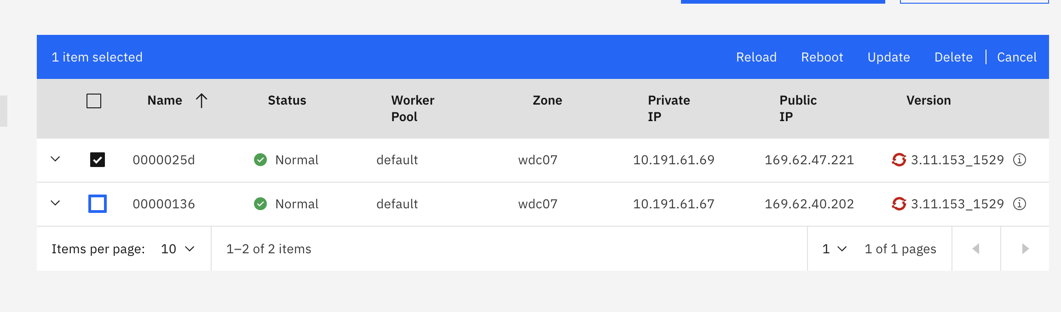
Running updates from the CLI/Web UI (sufficient worker capacity)
Schedule the rolling update of workers (default behavior will have max 20% workers offline)
ibmcloud oc worker update --cluster <cluster_name_or_ID> --worker <worker_node1_ID> --worker <worker_node2_ID> …
Confirm that the update is complete
oc get nodes
Web UI – navigate to the Worker Nodes, select desired nodes to update and click on ”Update”

Slide 6
Temporarily adding capacity through a worker pool
Create a worker pool with the number of worker nodes that you want to replace
ibmcloud oc worker-pool create classic --name <pool_name> --cluster <cluster_name_or_ID> --flavor <flavor> --size-per-zone <number_of_workers_per_zone>
ibmcloud oc worker-pool ls --cluster <cluster_name_or_ID> # Verify that the worker pool is created.
ibmcloud oc zone add classic --zone <zone> --cluster <cluster_name_or_ID> --worker-pool <pool_name> --private-vlan <private_VLAN_ID> --public-vlan <public_VLAN_ID>
#Add the zone to your worker pool that you retrieved earlier. When you add a zone, the worker nodes that are defined in your worker pool are provisioned in the zone and considered for future workload scheduling. If you want to spread your worker nodes across multiple zones, choose a multizone-capable zone.
Cleaning up a worker pool:
ibmcloud oc worker-pool rm --worker-pool <pool_name> --cluster <cluster_name_or_ID>
#Remove the worker pool with the old machine type. Removing a worker pool removes all worker nodes in the pool in all zones. This process might take a few minutes to complete.
ibmcloud oc worker-pool ls --cluster <cluster_name_or_ID>
#Verify that the worker pool is removed.

